Slide 1
JOURNEY PPT
Foundation Training
18 Aug – 20 Aug
- Musaddiq Shariff

Slide 2
DAY - 1
Introduction to Business Analysis
Requirement Analysis – Functional and Non- functional
Waterfall VS Agile methodology
Sprint – What, Why, How?
Scrum meeting – practical exposure : Teams were made, and a dry run of a scrum meeting conducted.
SDLC Life cycle – Basic concepts of a software development cycle was explained, the role and importance of the Business analyst was explained

Slide 3
DAY – 1 cont..
Designing of Use case diagram and Scenario based model – A hands-on activity was conducted by writing use cases for a chosen project.
Overview of Gantt chart was given with some practical examples
User stories – What is its importance?
Story point estimation and scrum fundamentals were explained in detail

Slide 4
DAY – 2
Azure Devops – Fundamentals of azure devops explained
DOD and DOR – Definition of Done and Definition of Ready, these terms were explained in detail.
Practical demo of Azure devops was given
Created sprints, user stories, epic, task, sub-task in the azure devops tool
Created some test cases in the same tool and tried to run these test cases
Burn-up and Burn-down chart differences were explained

Slide 5
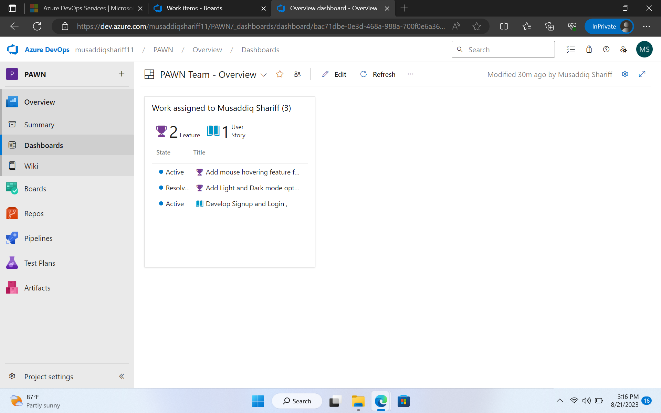
Azure Dashboard

Slide 6
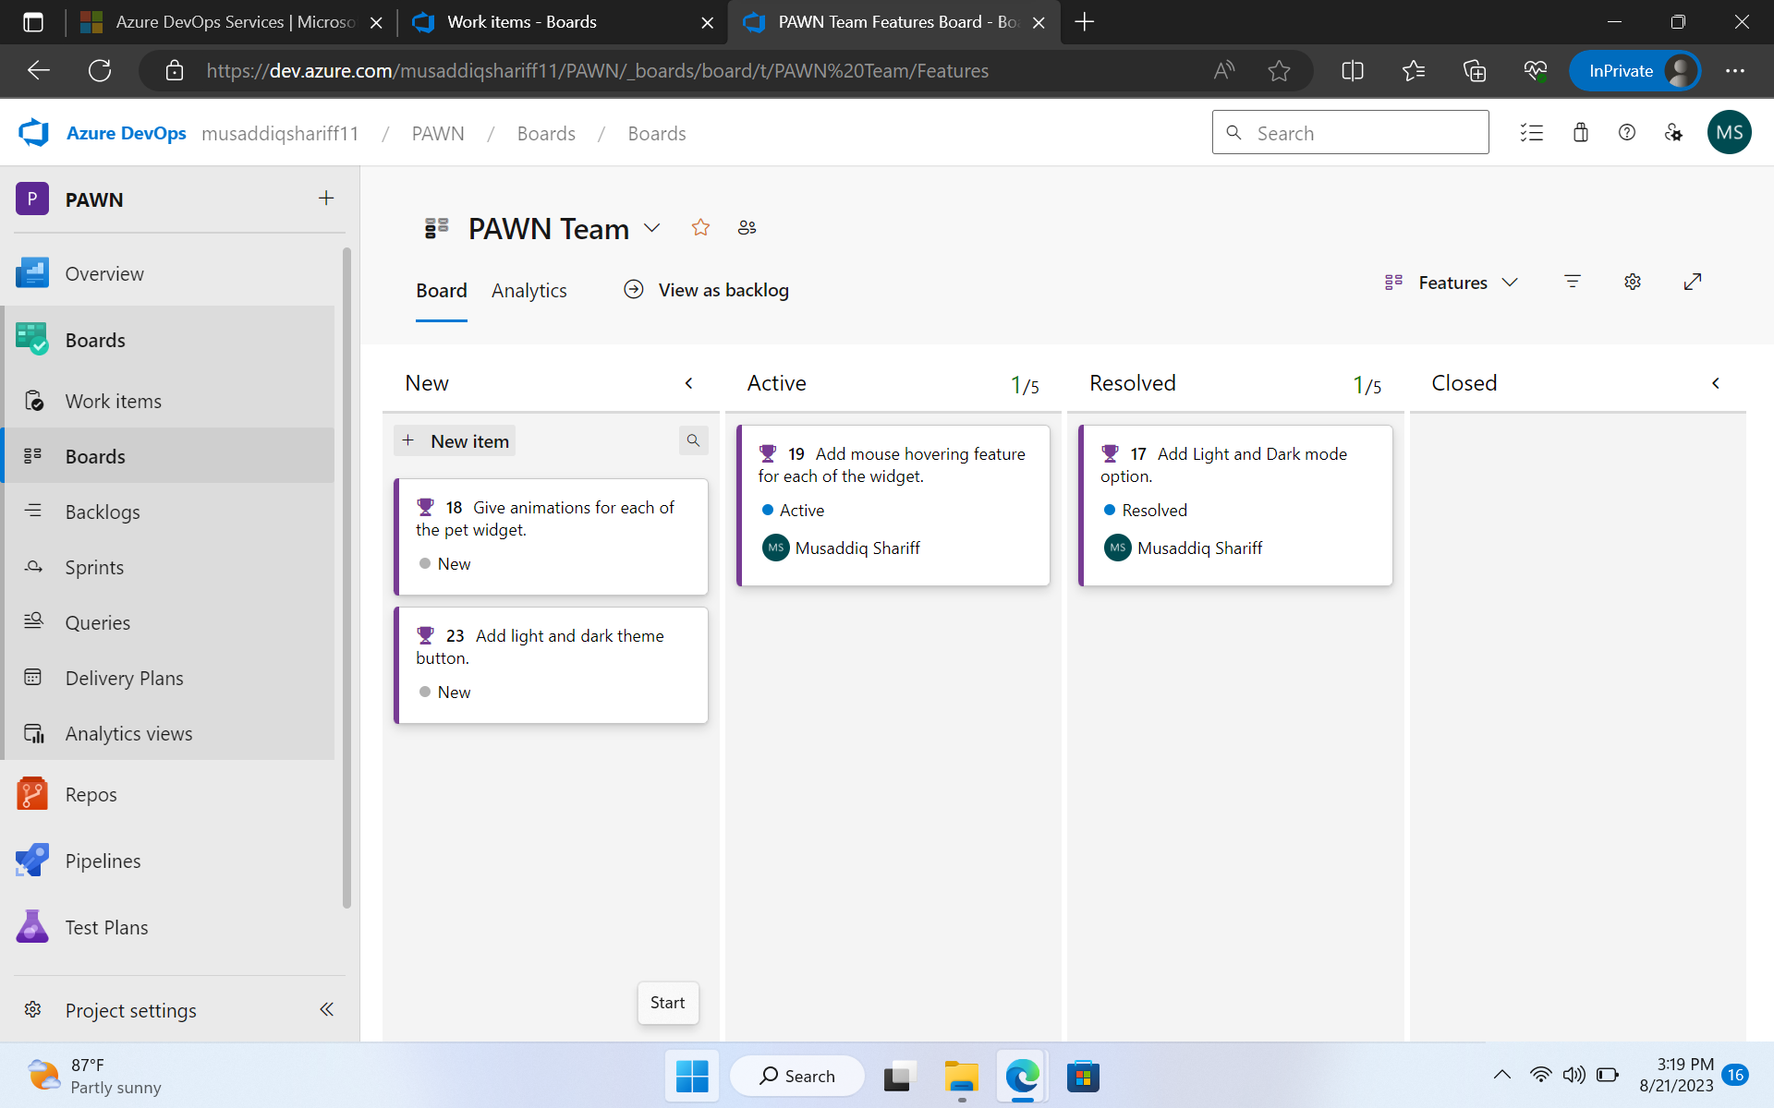
Scrum Board

Slide 7
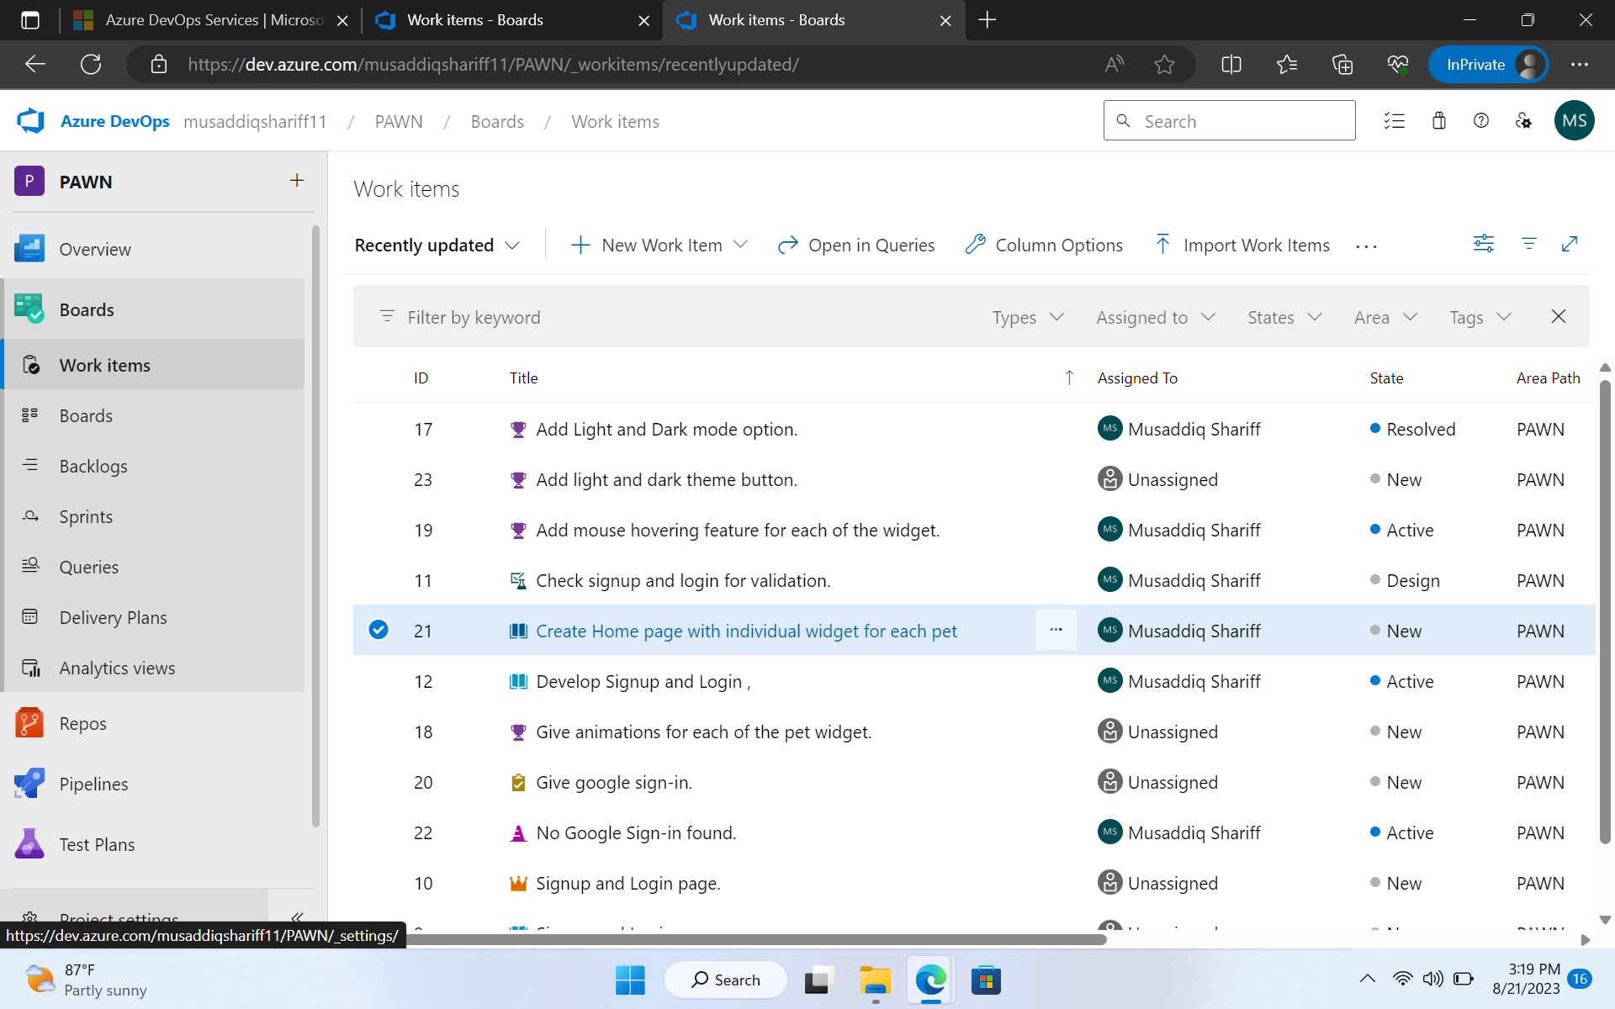
Work Items

Slide 8
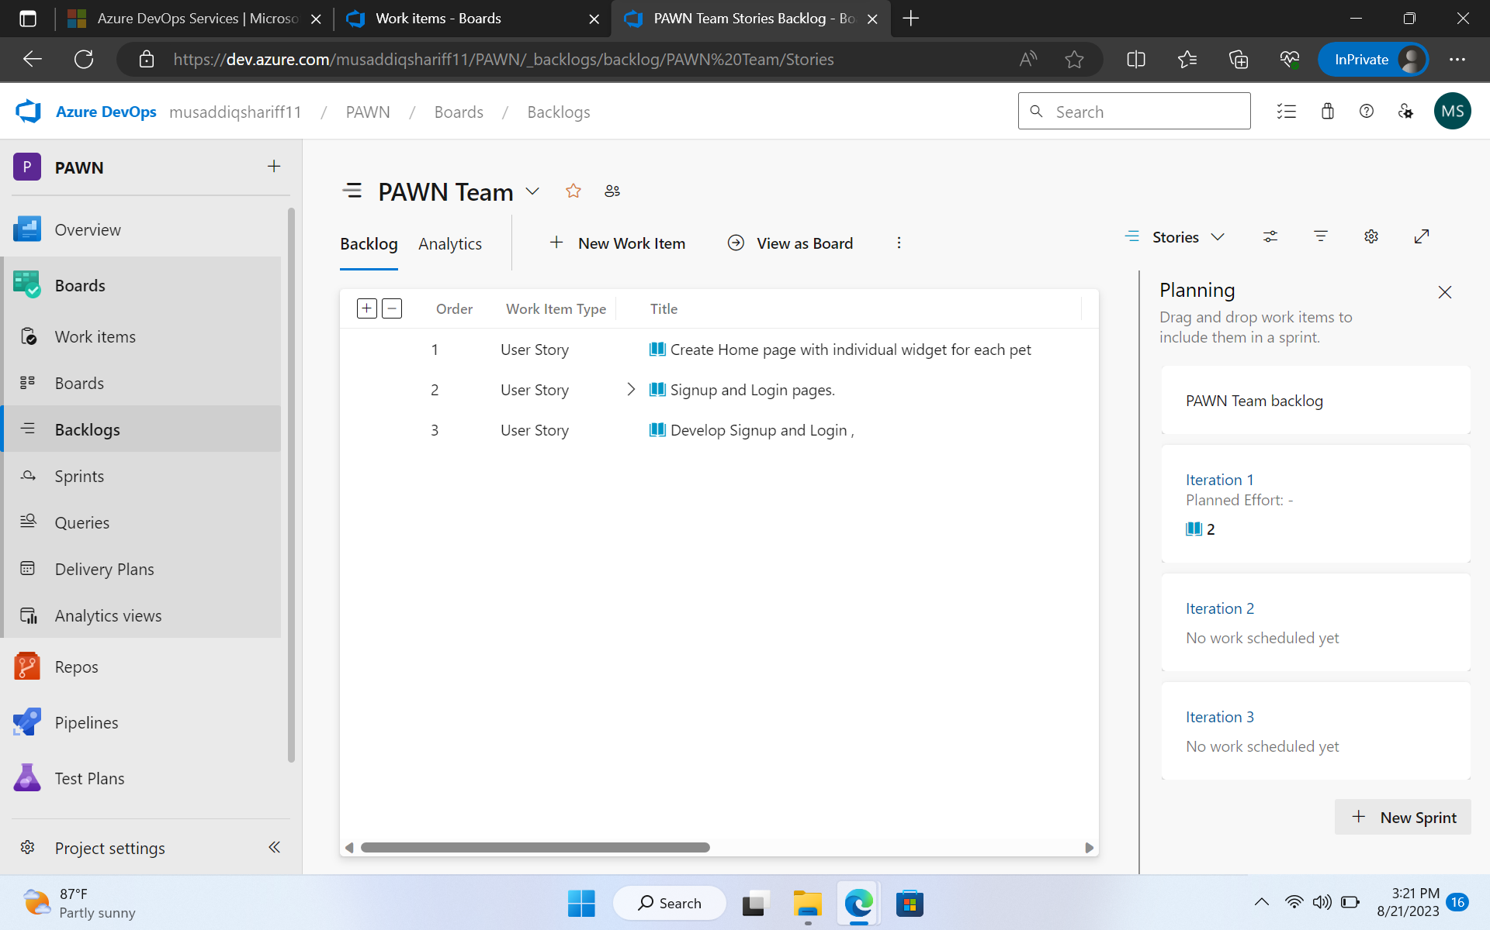
Backlogs

Slide 9
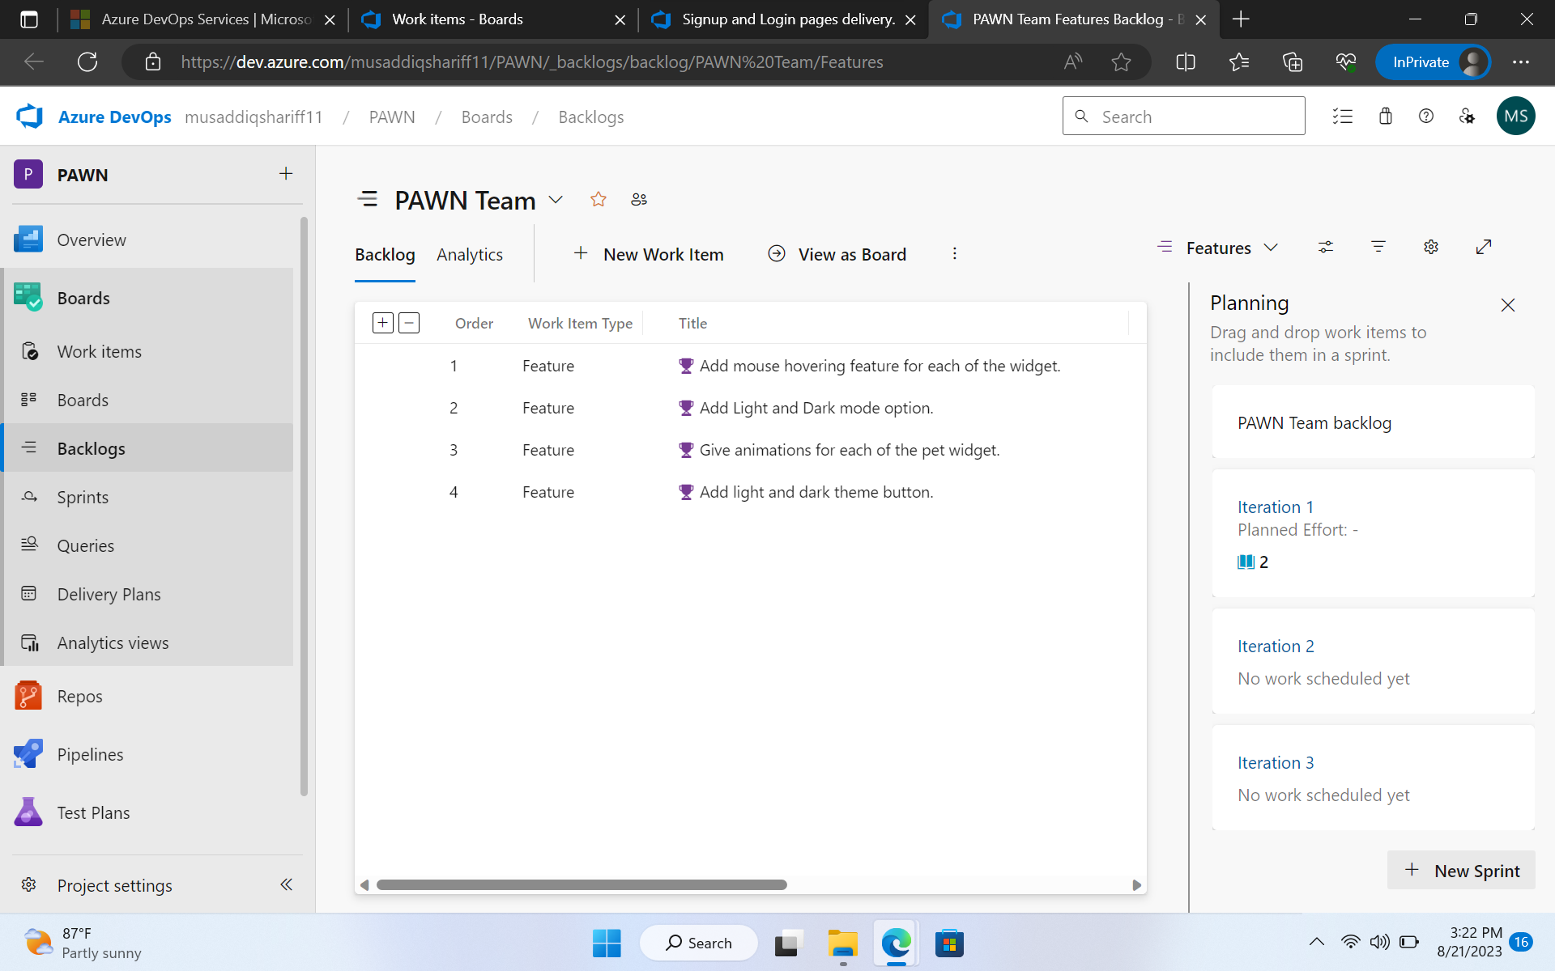
Adding new features

Slide 10
DAY 3 – DBMS
Basics of DBMS was thoroughly understood.
Relational and Non-relational databases and its types were explained and understood
Types of SQL languages like – DDL, DML, DQL, DCL, TCL were explained with examples
Some basic queries were executed on the online compiler to get clear understanding

Slide 11
DAY – 3 – DBMS cont.. Presentation
A team presentation was given on some DBMS related topics
Our team took Normalization topic
We worked thoroughly and understood about the basics of the normalization
Basic concepts of normalization of 1NF, 2NF, 3NF, BCNF, 4NF and 5NF was explained by each of us in the team
Other teams also presented other basic DBMS topics like subquery, nesting, query execution, JOINS, etc..

Slide 12
DAY – 4 -TESTING
The need of Testing in Software development life cycle was clearly understood.
Different types of testing such as Unit testing, System testing, integration testing was done.
Different type of testing methods such as White Box , Grey box, Black box testing was explained in terms of practical applications.
The Testing life cycle was clearly understood in terms of software perspective.

Slide 13
DAY – 5 - DEVOPS and Github
Use of Github in software engineering was learnt.
Creating repository, pull, push commands
Installing and initializing git in the local machine
Cloning a repository and pull code from the github account to into the local machine
Creating a .yml file to understand the workflow
A sample .yml file was executed and the results are examined under the ‘Actions’ in the Github menu

Slide 14
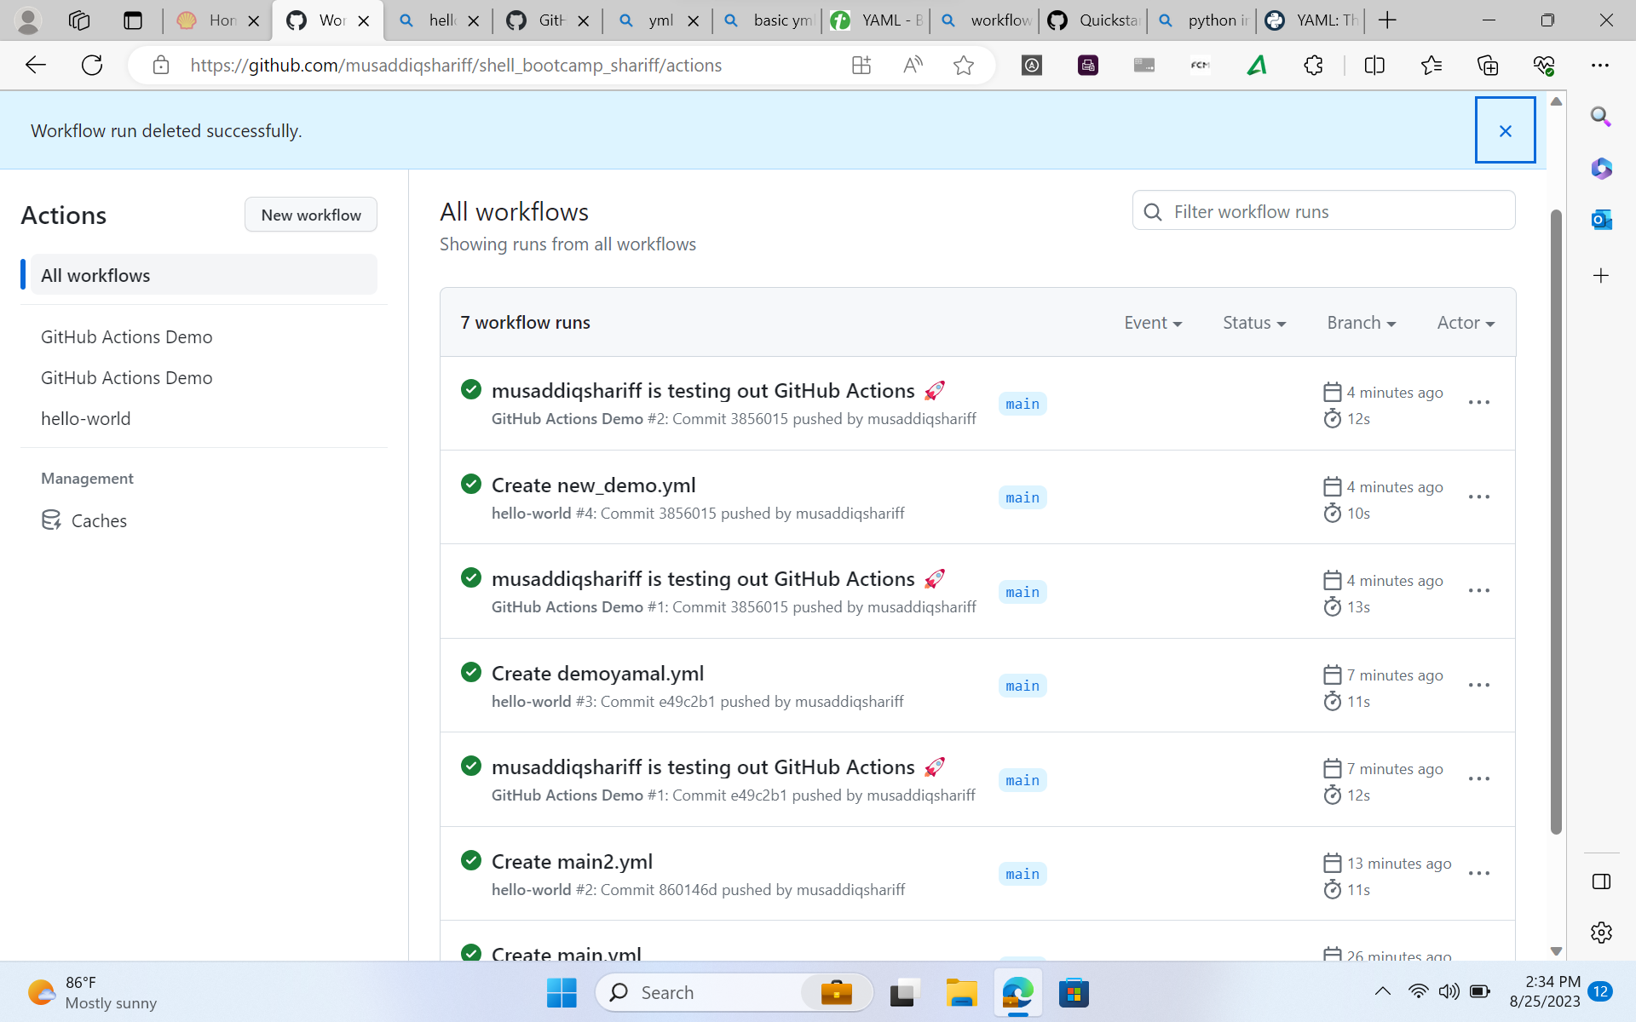
Workflows

Slide 15
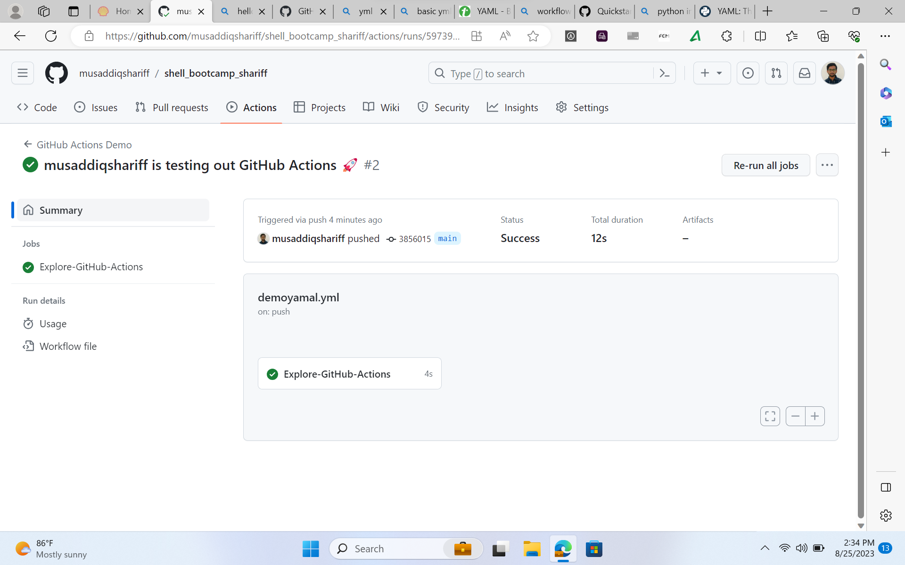
Workflows

Slide 16
DAY – 6 – Cloud Computing
Basics of Cloud Computing was thoroughly explained
Cloud architecture and its components was explained
Different Cloud Service models like Iaas, SaaS, PaaS was explained
Clear differentiation between these terminologies were explained
Virtualization and its advantages were explained
Cloud Storage and its service providers were listed and an overview of the same was provided
Microsoft Azure platform is used and a sample for demonstration of virtual machine is created and explored.

Slide 17
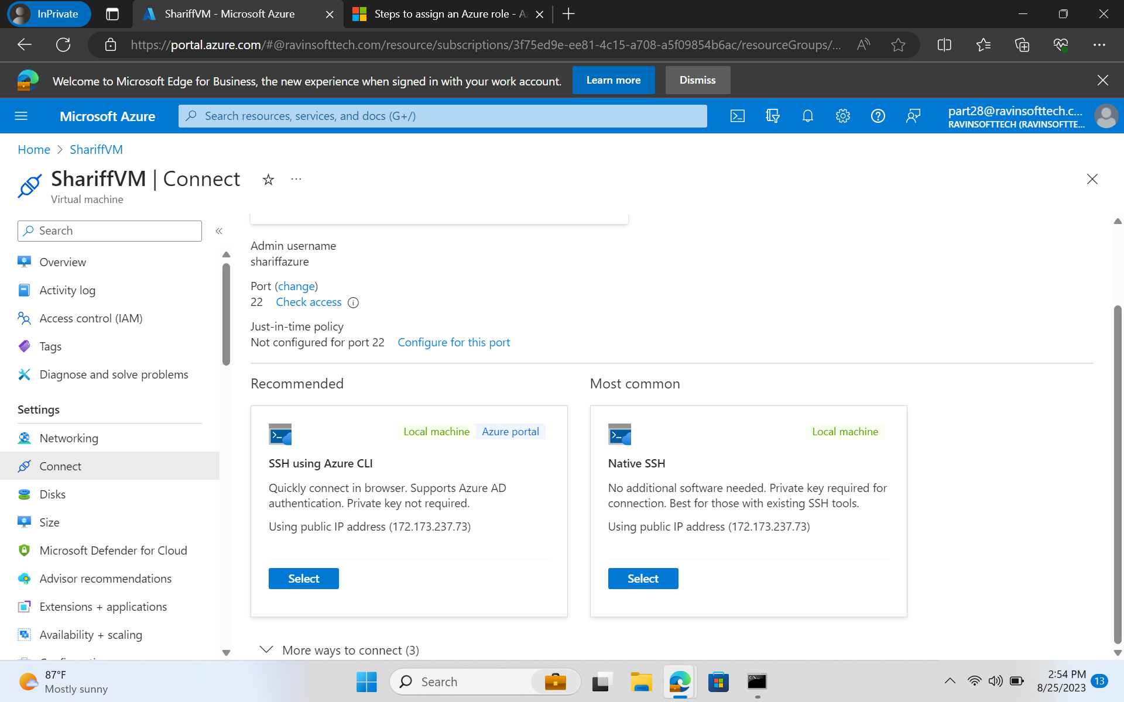
Virtual Machine – Microsoft Azure

Slide 18
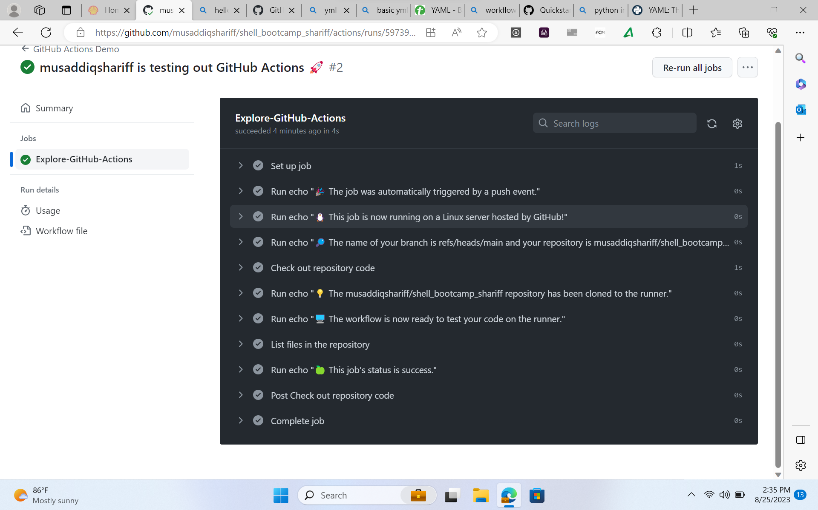
Virtual Machine – Microsoft Azure

